Slide 1
Applied Machine learning
Regent College London
SWE6302

Slide 2
Applied Machine LearninG learning
SWE6302

Slide 3

Applied Machine learning
INTRODUCING TO MACHINE LEARNING

Slide 4
Learning objectives
Understand the importance of the data
Understand the use cases of machine learning
Understand the key concepts of machine learning
Understand the importance of AI & Machine learning
Examples of Machine Learning
Language for Machine Learning

Slide 5
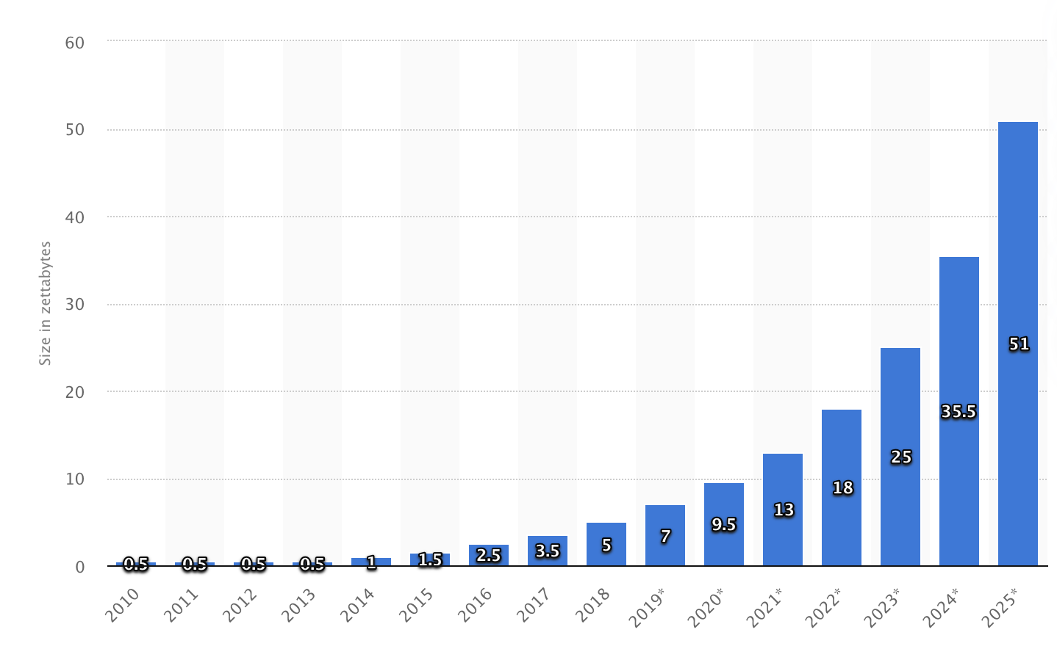
Data
Annual size of real time data in the global datasphere from 2010 to 2025
https://www.statista.com/statistics/949144/worldwide-global-datasphere-real-time-d

Slide 6
Introduction
The world data storage capacity has doubled about every 3 years from 1980s
There are 2.5 quintillion (1018) bytes of data created each day at our current pace
More data doesn’t mean more information! (1ZB=10^21 bytes)
The surge of data calls for automated methods of data analysis, which is what machine learning provides!

Slide 7
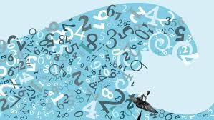
Data & information
“We are drowning in information and starving for knowledge.” (RD Roger)
Why did Facebook acquire WhatsApp by paying a huge price of $19 billion
Notes:
access to the users’ information that Facebook may not have but WhatsApp will have.

Slide 8
Forms of data
Numerical
It is all numbers
Categorical
Also called a nominal value
E.g. True, False
Gender ,Models of PC etc
Ordinal
It is like nominal but with the ordering of data
E.g. Positions, Sizes, Happiness rating

Slide 9
How data is used in ML
Data is split into training data, validation data and Testing data
Training data: Is used to create a model, It is input and the output which the model actually see.
Validation data helps in checking or evaluating the model whether it can make correct predictions.
Testing data: This data is used when the model has been trained. This data is fed into the trained model and check the output from this by comparing it with the actual values.

Slide 10
Simplified Diagrammatic Implementation of ML
Training Data
Machine Learning Algorithm
Training
Prediction
“Live” Data / Test Data
Trained Model
Prediction

Slide 11
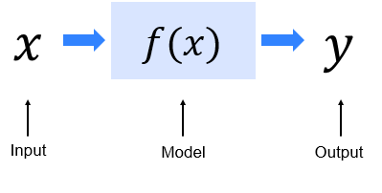
ML in Mathematical Representation

Slide 12
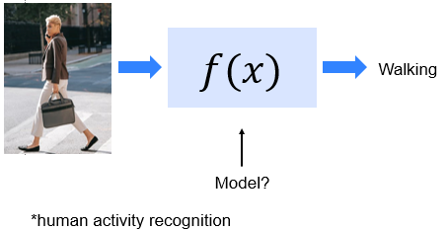
An ML Exemplar

Slide 13
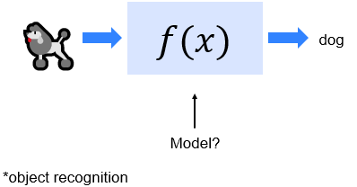
Another ML Exemplar

Slide 14
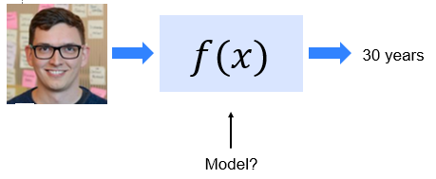
Yet Another ML Exemplar
* age recognition

Slide 15
Example of ML
Car manufacturing company: Build a model to predict the fuel efficiency of a car
Data from different car models, with corresponding weight and engine size, and their fuel efficiency. (Labelled data)
weight and the engine size (Input or features)
Predict : fuel efficiency (target variable (or label)
Split it into two sets: training set and testing set
Preprocessing could be needed for example, to fill missing values or handle outliers that might affect your model accuracy.

Slide 16
Advantages and disadvantages of ML
Automate decision making for complex tasks.
Personalize experiences for customer satisfaction
Cost saving for business
Improvement in accuracy of predictions with complex data
Privacy of data can raise concerns
Poor data can compromise the predictions
Requires high technical skills

Slide 17
Why do we want machines to learn

Slide 18
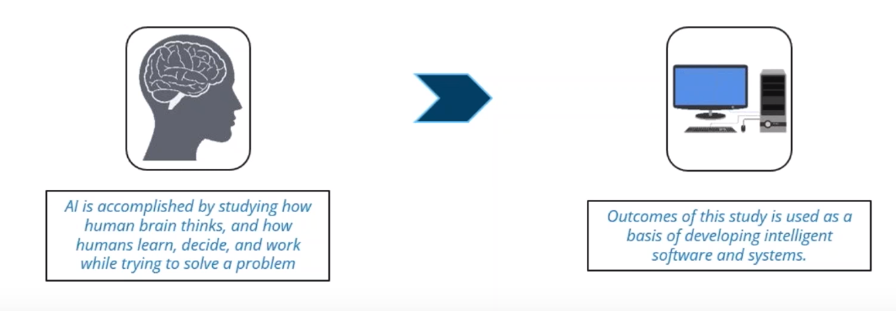
What is AI?
Artificial Intelligence is the capability of a machine to imitate intelligent human behaviour.
AI is achieved by mimicking a human brain, by understanding how it thinks, how it learns, decides, and work while trying to solve a problem.

Slide 19
Traditional types of AI
Narrow AI: is dedicated to performing a single task, such as playing chess or identifying various objects. It has a vast range of applications in today's world, from guiding autonomous vehicles to detecting spam emails or facial recognition.
Broad AI: in contrast, can handle a variety of tasks within a specific domain. For example, an AI developed for healthcare could interpret medical images, analyse patient data and even suggest treatment plans, all within its realm of expertise.
General AI: on the other hand, has the most expansive intelligence, capable of functioning effectively across multiple domains. Although it's in the early stages of development, general AI harbours the potential to exceed the capabilities of both narrow and broad AI, paving the way for machines capable of human-like thinking and reasoning.

Slide 20
Relationship between AI, ML, DL
Artifical
Artificial Intelligence
Machine Learning
is a subset of
Artificial Intelligence
Machine learning focuses on developing algorithms that allow computers to learn from data and make predictions or decisions without being explicitly programmed.
Machine Learning
Deep Learning
Deep Learning
is a subset of
Machine Learning
Deep Learning uses neural networks to simulate human like decision making

Slide 21
Difference between ML vs DL
Machine learning focuses on developing algorithms that allow computers to learn from data and make predictions or decisions without being explicitly programmed. It includes techniques like supervised learning, unsupervised learning, semi-supervised and reinforcement learning. Machine learning models often rely on structured data and require human intervention for tasks like feature engineering.
Deep learning, on the other hand, is a specialized branch of machine learning that uses artificial neural networks with multiple layers (hence "deep"). These networks are designed to mimic the structure and functioning of the human brain. Deep learning excels at handling large datasets and complex tasks such as image recognition, natural language processing, and autonomous systems. Unlike traditional machine learning, deep learning models automatically extract features from raw data, reducing the need for manual feature engineering.

Slide 22
AI, ML, DL?
AI Experiments - Experiments with Google
AI is the science of making things smart-1950’s
ML: An approach to achieve artificial intelligence through systems that can learn from experience to find patterns in a set of data. 1980’s
Or we can say that ML is about creating or applying algorithms or a set of rules that learns from data and make predictions on it.
Deep learning: Drives large progress towards achieving narrow AI systems. 2010’s (code structure you write are arranged in layers that mimic the human brain ,learning patterns or patterns.

Slide 23
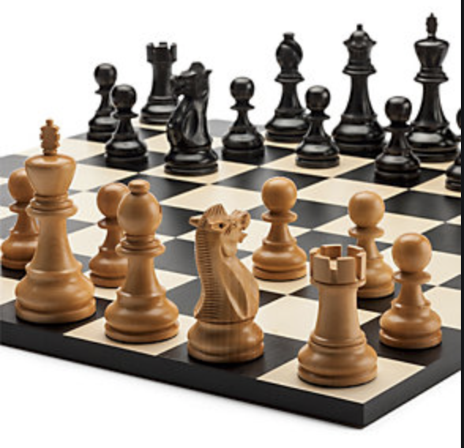
How programs use data
Useful programs learn something
With traditional computing, some data need
to be input in a computer program to get the output
Definition of Machine Learning:
“Field of study that give computers the ability to learn without being explicitly programmed” – Arthur Samuel (1959)
Computer pioneer who wrote first self-learning program, which played checkers – learned from “experience”
Invented alpha-beta pruning (1st algorithm used in ML) – widely used in decision tree searching

Slide 24

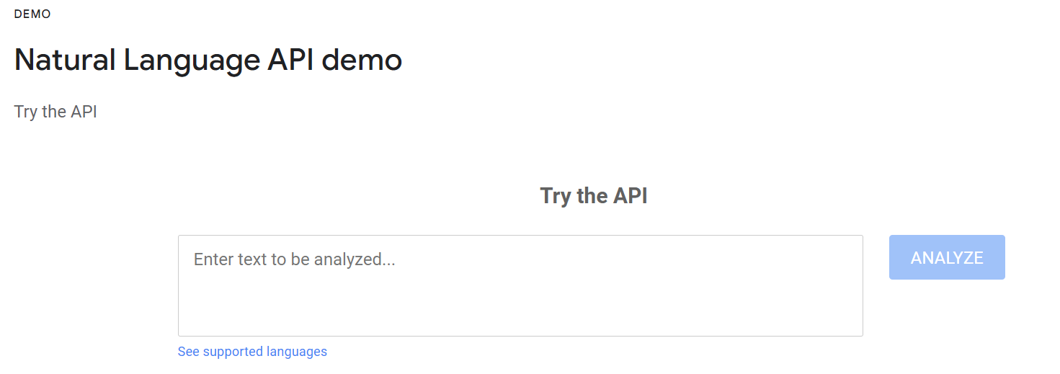
Examples to try out
https://cloud.google.com/speech-to-text
https://cloud.google.com/natural-language

Slide 25
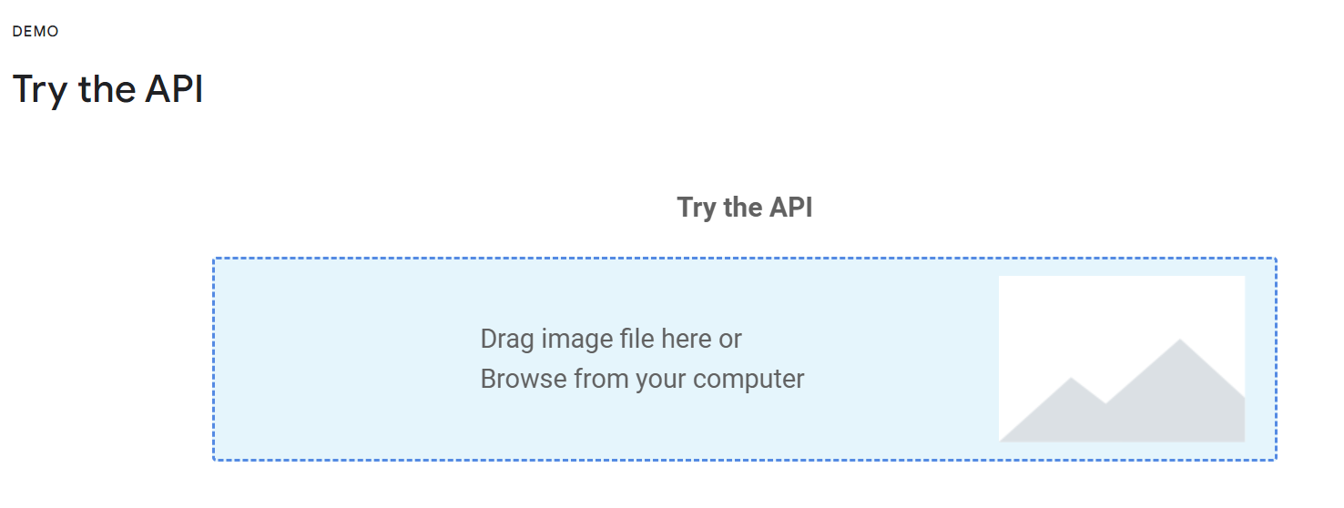
Examples to try out
Derive insights from images and videos with pre-trained APIs, AutoML, or custom models.
https://cloud.google.com/vision/

Slide 26
Machine learning (ML) applications
Speech recognition-Cortana
Traffic predictions
Social media recommendations
Image recognition
Could you think on more examples?
Learning Machines are with us every single day

Slide 27
What is ML?
A branch of AI
AI
Machine Learning
Supervised Learning
Unsupervised Learning
Natural language processing
Text generation
Expert systems
Speech
Vision
Planning
Robotics
Semi-supervised
Question answering
Context extraction
[…]
To txt / from txt
Navigation
Reinforcement Learning

Slide 28
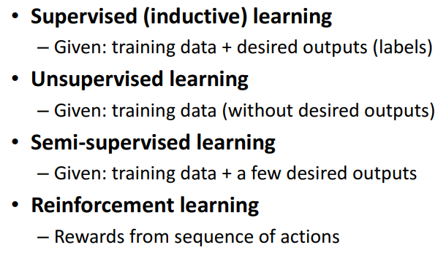
Different types of ML Techniques

Slide 29
Different types of ML Techniques
Machine Learning
Supervised
Reinforcement
Unsupervised
Continuous
Regression
Discrete
Classification
No target variable
Clustering
Association
Continuous
No target variable
Classification
Control
Semi-supervised
Continuous
Discrete
No target variable
Regression
Classification
Clustering

Slide 30
Example of ML
Identifying the zip code from handwritten digits on an envelope
Determining whether a tumor is benign based on a medical image
Detecting fraudulent activity in credit card transactions
Notes:
Examples of supervised machine learning tasks include: Identifying the zip code from handwritten digits on an envelope Here the input is a scan of the handwriting, and the desired output is the actual digits in the zip code. To create a dataset for building a machine learning model, you need to collect many envelopes. Then you can read the zip codes yourself and store the digits as your desired outcomes.
Determining whether a tumor is benign based on a medical image Here the input is the image, and the output is whether the tumor is benign. To create a dataset for building a model, you need a database of medical images. You also need an expert opinion, so a doctor needs to look at all of the images and decide which tumors are benign and which are not. It might even be necessary to do additional diagnosis beyond the content of the image to determine whether the tumor in the image is cancerous or not.
Detecting fraudulent activity in credit card transactions Here the input is a record of the credit card transaction, and the output is whether it is likely to be fraudulent or not. Assuming that you are the entity dis‐ tributing the credit cards, collecting a dataset means storing all transactions and recording if a user reports any transaction as fraudulent.

Slide 31
Other examples of ML
Identifying topics in a set of blog posts from a big article. There are no known outputs in this case.
Segmenting customers into groups with similar preferences. Examples of groups could be parents, customer records, book-works or gamers. Also, there is no knowledge of which groups these are as no known outputs again.
Detecting abnormal access patterns to a website: As you only observe traffic, and you don’t know what constitutes normal and abnormal behavior and again there is no known outputs
Notes:
Müller, A. C., & Guido, S. (2016). Introduction to machine learning with python : A guide for data scientists. O'Reilly Media, Incorporated.
Unsupervised algorithms are the other type of algorithm that we will cover in this book. In unsupervised learning, only the input data is known, and no known output data is given to the algorithm. While there are many successful applications of these methods, they are usually harder to understand and evaluate. Examples of unsuper‐ vised learning include:Identifying topics in a set of blog posts If you have a large collection of text data, you might want to summarize it and find prevalent themes in it. You might not know beforehand what these topics are, or how many topics there might be. Therefore, there are no known outputs.
Segmenting customers into groups with similar preferences Given a set of customer records, you might want to identify which customers are similar, and whether there are groups of customers with similar preferences. For a shopping site, these might be “parents,” “bookworms,” or “gamers.” Because you don’t know in advance what these groups might be, or even how many there are, you have no known outputs. Detecting abnormal access patterns to a website To identify abuse or bugs, it is often helpful to find access patterns that are differ‐ ent from the norm. Each abnormal pattern might be very different, and you might not have any recorded instances of abnormal behavior. Because in this example you only observe traffic, and you don’t know what constitutes normal and abnormal behavior, this is an unsupervised problem.

Slide 32
APPLICATION OF ML
Computer vision: to recognize objects, people, and other elements in images and videos
Natural language processing: generate human language, including tasks such as translation and text classification.
Recommendation systems: recommend products or content to users based on their past behavior and preferences.
Fraud detection: to identify fraudulent activity in areas such as credit card transactions and insurance claims.
Healthcare: to predict disease outbreaks, identify potential outbreaks, or predict patient outcomes.
Finance: to predict stock prices, identify fraudulent activity, or identify potential investment opportunities.
Notes:
Computer vision: Machine learning algorithms can be used to recognize objects, people, and other elements in images and videos.
Natural language processing: Machine learning algorithms can be used to understand and generate human language, including tasks such as translation and text classification.
Recommendation systems: Machine learning algorithms can be used to recommend products or content to users based on their past behavior and preferences.
Fraud detection: Machine learning algorithms can be used to identify fraudulent activity in areas such as credit card transactions and insurance claims.
Healthcare: Machine learning algorithms can be used to predict disease outbreaks, identify potential outbreaks, or predict patient outcomes.
Finance: Machine learning algorithms can be used to predict stock prices, identify fraudulent activity, or identify potential investment opportunities.

Slide 33
Common language for ML
Python
Has libraries for data loading , visualization, statistics, natural language processing, image processing.
Toolbox is vast and includes large array of general and specific purpose functionality for data scientists
Another advantage is ability to interact directly with code using tools like Jupyter Notebook or Google Colab Notebook (online cloud version of Jupyter Notebook).
Why it is getting popular
Explosive growth of data in a great variety of fields, Cheaper storage devices with higher capacity, Faster communication,Better database management systems and Rapidly increasing computing power

Slide 34
Scikit-learn
Is open source
Is constantly being developed and improved as it has an active user community
Contains various machine learning algorithms along with comprehensive documentation
Scikit-learn is a popular tool

Slide 35
Is AI beneficial for the society?
https://youtu.be/RsNTMfnWIt8

Slide 36
Introduction to machine learning:
mit
https://www.youtube.com/watch?v=h0e2HAPTGF4

Slide 37
References
Müller, A. C., & Guido, S. (2016). Introduction to machine learning with python : A guide for data scientists. O'Reilly Media, Incorporated.
Clarusway.com. 2020. Seaborn Cheat-Sheets. https://clarusway.com/wp-content/uploads/2020/12/Seaborn_CheatSheets.pdf
Google Cloud Tech. 2017.What is Machine Learning?.[Online].Available at: https://www.youtube.com/watch?v=HcqpanDadyQ
Google Cloud Tech.2017.The 7 steps of machine learning. ?.[Online].Available at:https://www.youtube.com/watch?v=nKW8Ndu7Mjw
Mohit Gupta_OMG :).2022.Introduction to Data in Machine Learning. ?.[Online].Available at: https://www.geeksforgeeks.org/ml-introduction-data-machine-learning/
Jason’s Machine Learning 101. 2022.Machine Learning.[Online].Available at: https://docs.google.com/presentation/d/1kSuQyW5DTnkVaZEjGYCkfOxvzCqGEFzWBy4e9Uedd9k/edit#slide=id.g24521cd995_0_441

